Slide 1
Global Health Ethics Global Health Course Workshop
Douglas Collins, M.D.
University of Cincinnati
Department of Family & Community Medicine,
Division of Global & Underserved Health

Slide 2
Goals:
Define GLOBAL HEALTH ETHICS
Describe the key principles of MEDICAL ETHICS
Review the historical development of ETHICS
Discuss the HUMAN RIGHTS approach in global health ethics
Apply global health ethics to important CURRENT ISSUES including resource limitations, human research among vulnerable populations, and limited healthcare professional human resources
List important GUIDING DOCUMENTS on GH Ethics physicians caring for vulnerable populations must know

Slide 3
Principles of Bio/Medical Ethics
Read the vignettes from “Ethical & Human Rights Concerns in Global Health” (Skolnik, Ch 4, p71).
What ethical or human rights issues are illustrated in each vignette?
Suraiya, 21y F in Afghanistan
John, 32y M in SSA
Malaria research, West African village
Primary Health Clinics, India

Slide 4
Ethical & Human Rights Issues
Suraiya
Right to healthcare access
Distributive justice
Inequity
John
Beneficence
Nonmaleficence
Dignity/respect
Malaria Research
Right to benefit from research
Beneficence
Resource limitations
Indian Government
Utilitarianism
Distributive justice
Right to healthcare access

Slide 5
What is Global Health Ethics?
Bioethics
Academic discipline
Interface of medicine and technology/law/theology/philosophy
(Clinical) Medical Ethics
Focused on quality of patient care
Committee-based using secular principles: Can you name the 4 main secular principles that provide our ethical framework in U.S. healthcare?
Public Health Ethics
Focuses on general public good
Macro-ethics emphasized over micro-ethics (eg, quarantine)
Global Health Ethics
Relatively new discipline informed by above disciplines
Holistic, multi-disciplinary
Emphasizes global community
Adds key principles of Social Justice: equity, equality, and health as a human right

Slide 6
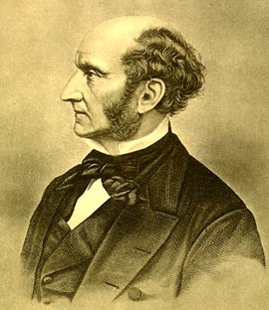
Principles of Medical Ethics
Autonomy
Beneficence
Nonmaleficence
(Distributive) Justice

Slide 7
Health Care Safety Study: Cambodia
Cambodia, like many developing/LMICs, has a “Dual Health Care System” in which there is a public/private mix approach to care as a result of resource limitations such as a national tax-base. Physicians, pharmacists, lab technicians, radiologists, etc, are all permitted to provide private care in addition to their assigned duties in the national healthcare system. The result is a pragmatic, business-approach to healthcare, often fragmented, with little oversight.
A 2001 study was performed to assess the safety of encounters in urban private practices:
Participants: 198 Private Practitioners in Phnom Penh
Results:
Record Taking: 30% asked name, 7% recorded notes
Information: 12% were given a diagnosis
Safety: 56% assessed as potentially hazardous encounters (eg, inappropriate steroids, surgeries, IV fluids; no fluid advice for diarrhea; incomplete courses or multiple antibiotics; polypharmacy)
What ethical principles/values are illustrated in the study?

Slide 8
Health Care Safety Study, Cambodia
What ethical principles/values are illustrated in the study?
Nonmaleficence violations
Informed consent/autonomy violations
Beneficence violations
Poor stewardship of resources
Exploitation of vulnerable populations

Slide 9
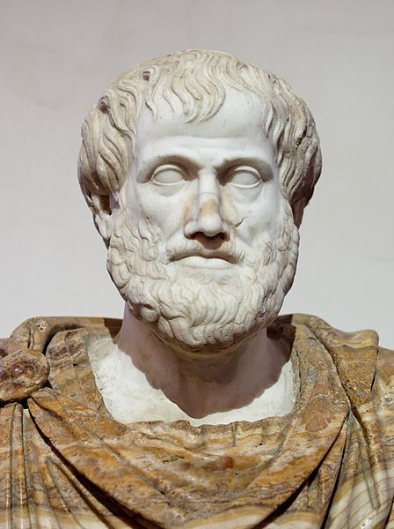
Ethics in the History of Western Philosophy
Ethics:
Branch of Philosophy dealing with morality/right and wrong
Ancient Western Contribution:
Hebrews - Torah/Old Testament Law/Ten Commandments
Greeks (5th – 4th C BC)
Socrates: Father of Moral Philosophy (Western)
Plato: Ideal Forms/Virtue Ethics – courage, temperance, wisdom, justice
Aristotle: Justice – treating equals equally
Christian – Christ’s “Sermon on the Mount” (Love your enemy, forgive, turn the other cheek, etc); Aquinas (13th C) – Faith, Hope, and Charity/Love

Slide 10
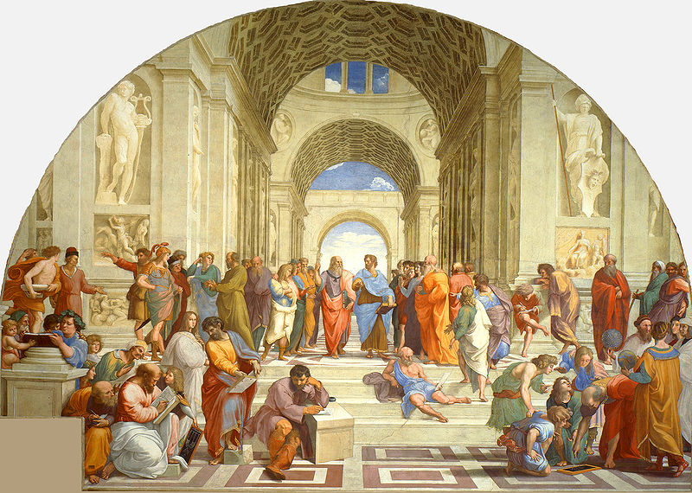
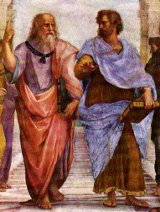
http://en.wikipedia.org/wiki/The_School_of_Athens
Notes:
School of Athens, Rafael c1500, in Vatican; Plato on LEFT – Ethics guided by heavenly “forms”; Aristotle on RIGHT – Ethics guided by earthly/concrete/empiric principles

Slide 11
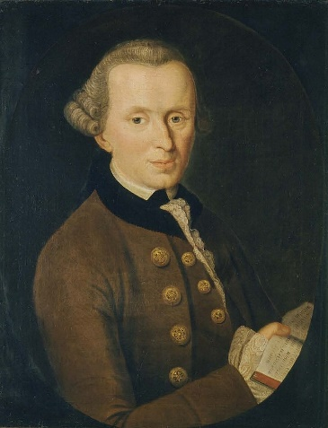
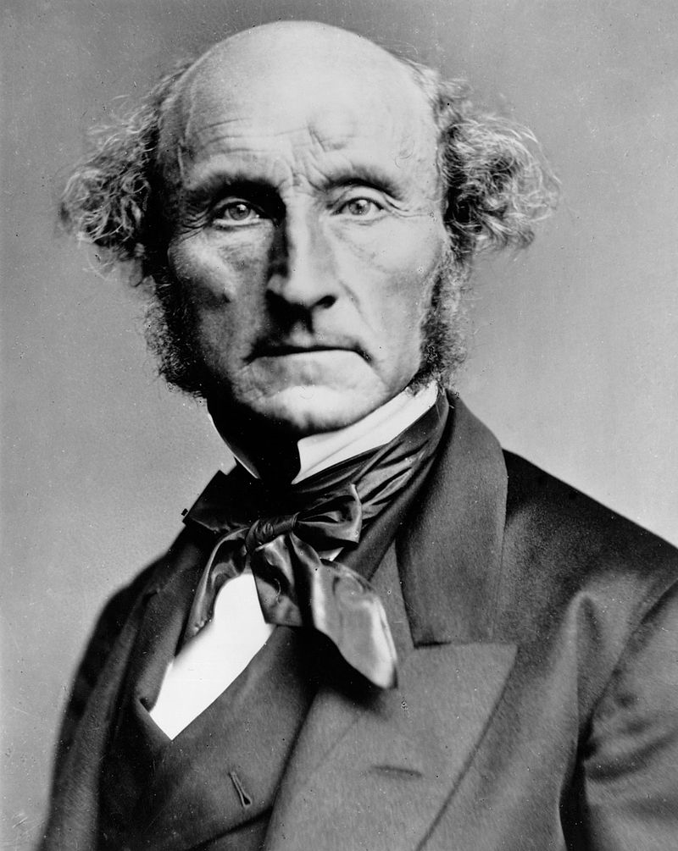
Two Modern Categories of Ethics
Deontological Ethics
Morality of an action is based on adherence to rules/duties (From “deon” for “duty”)
Right/wrong depend on motive, not consequence
Developed by Immanuel Kant; Kant’s Categorical Imperative (1785):
"Act only according to that maxim whereby you can, at the same time, will that it should become a universal law.“
Utilitarian Ethics
The moral value of an action is determined by its consequences
First articulated by Jeremy Bentham (late 1700s), then John Stuart Mill (“Harm Principle” (1859):
“The sole end for which mankind are warranted, individually or collectively, in interfering with the liberty of action of any of their number, is self-protection…The only purpose for which power can be rightfully exercised over any member of against his will, is to prevent harm to others…In the part which merely concerns himself, his independence is, of right, absolute. Over himself, the individual is sovereign.” On Liberty, 1859*

Slide 12
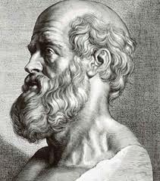
Healthcare Codes & Oaths…
Ayurvedic Code, Susruta (6th C BC)
Hippocratic Oath (5thC BC)
Oath of Maimonides (12thC BC)
Physician’s Oath (WMA, Geneva, 1948)
Oath of the Muslim Physicians (IMA 1977)
Christian Physician’s Oath (CMDA 1991)
Taylor’s Free Version of the Hippocratic Oath (1966)
Notes:
An ethical tool that has arisen historically to protect patients, who are always vulnerable in the power differential of patient/provider, and to guide providers

Slide 13
Carl Taylor’s “Free Version of the Hippocratic Oath” (1966)
Example of an oath that uniquely included many Global Health Ethics elements.
Includes:
Share science, regardless of nationality
Secure esteem of and collaborate with national physicians
Worldwide mindset over National borders
Look for causes of causes (SDH)
Wholistic approach w/ respect for culture/beliefs
Community concern, without forgetting individual

Slide 14
Key Principles in Global Health Ethics
GH Ethics as a discipline recognizes that other approaches to ethics do not often adequately address principles of Social Justice:
Equity
Reciprocity
Complementarity
Sustainability
Health as a Human Right

Slide 15
Equity?: Guess the Number…
The richest 1/5th of the world consume ______% of all goods and services.
The 3 richest people in the world have assets that exceed the combined GDP of _____ least-developed countries.
The world’s 358 richest individuals have a combined wealth equal to the annual income of the poorest _____ % of the world’s population.
90% of global expenditure on medical research is focused on diseases causing _______% of the global burden of disease
Of 1,223 new drugs developed between 1975 and 1997, only ______ were for the treatment of tropical diseases
_______% of U.S. government research is devoted to military research
U.S. spends _______% of total health care expenditures in the world on 5% of the world’s population
From Spann, Stephen, AAFP (Accessed: www.fmdrl.org 10/2/2009)
Benatar SR et al. Global health ethics: the rationale for mutual caring. International Affairs 2003;79:107-138
Notes:
86 ; 48; 45; 10; 13; 66; 50 – These numbers highlight how Bioethics, Medical Ethics, and Public Health Ethics, as disciplines, do not adequately address all of health ethics

Slide 16
Human Rights in Global Health Ethics
Take a few minutes to read “The Importance of Ethical & Human Rights Issues in Global Health” and “The Foundations for Health and Human Rights” (Skolnik, Ch 4, pp71-73)
Discussion Questions:
Do you think people have a “right to health”?
How are human rights linked to health?
What are strengths and weakness of a rights-based approach to ethics?
Notes:
Argument against health as a human right: “Bottomless Pit” – how do you decide what health is a right? Who is it a right for?

Slide 17
Health & Human Rights Documents
WHO Constitution 1946: The enjoyment of the highest attainable standard of health is one of the fundamental rights of every human being.
UN Declaration of Human Rights (UNDHR)1948, Article 25: Everyone has the right to a standard of living adequate for the health and well-being of himself (sic) and of his family…
Declaration of Alma-Ata 1978: Primary health care is essential health care…
International Bill of Human Rights =
UNDHR +
ICCPR (International Covenant on Civil & Political Rights) +
ICESCR (Intl Covenant on Economic, Social, and Cultural Rights)

Slide 18
Human Rights in Global Health Ethics
Read the bracketed sections from pp xxiv-xxvi and pp17-19 of Paul Farmer’s Pathologies of Power
Discussion questions:
How does Paul Farmer expand on Human Rights as the foundational principle in Global Health Ethics?
How does a rights-based approach affect our approach to HIV and TB management?
Notes:
Human Rights argument addresses broader concepts, such as social conditions (“structural violence”) that may be otherwise ignored by bioethics approaches

Slide 19
Research in Global Health Ethics
History has played a central role in informing the ethics of research on human subjects
Victims typically are those belonging to “vulnerable populations” such as:
Prisoners of war (EXAMPLE: Nazi Medical Experiments)
People with developmental delays and mentally retardation (EXAMPLE: Willowbrook Hepatitis Study)
Poor, uneducated minorities (EXAMPLES: Tuskegee Syphilis Study; Henrietta Lacks’ “HeLa” Cells)
Poor, medically needy (EXAMPLE: Short Course AZT Trials)
Adapted from Nancy Elder, Global Health Research Ethics History Lessons, 2016

Slide 20
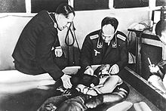
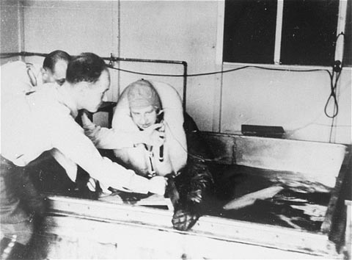
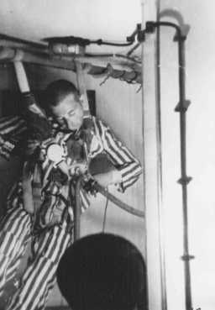
Nazi “Medical” Experiments
A series of medical experiments occurred on large numbers of prisoners by the German Nazi regime in its concentration camps during World War II. Prisoners were coerced into participating: they did not willingly volunteer and there was never informed consent. Typically, the experiments resulted in death, disfigurement or permanent disability.
Notes:
Despite 1931 Reich Circular on Human Experimentation that included strict requirement for consent

Slide 21
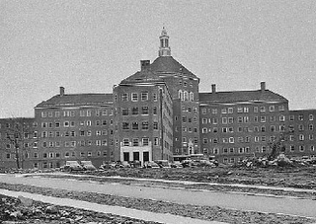
Willowbrook Hepatitis Study
1963-66: Studies at Willowbrook State School, a New York institution of “mentally defective persons’ were designed to gain an understanding of the natural history of infectious hepatitis and subsequently to test the effects of gamma globulin in preventing or ameliorating the disease. Children were deliberately infected with hepatitis virus; early subjects were fed extracts of stools from infected individuals and later subjects received injections of more purified virus preparations. When overcrowding closed the school to new admissions, only those who agreed to participate in the study could be admitted.

Slide 22
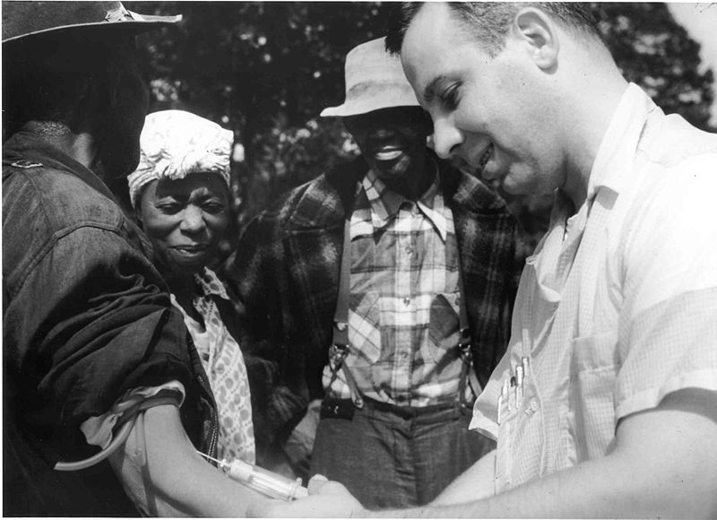
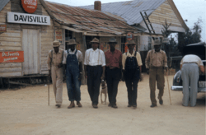
Tuskegee Syphilis Study
1932-1972: This research used disadvantaged, rural black men to study the untreated course syphilis. The men were offered free examinations and medical care, but were not informed of their disease, that they were participating in research, or that the research would not benefit them. Further, participants were deprived of effective treatment in order not to interrupt the project, long after such treatment became generally available

Slide 23
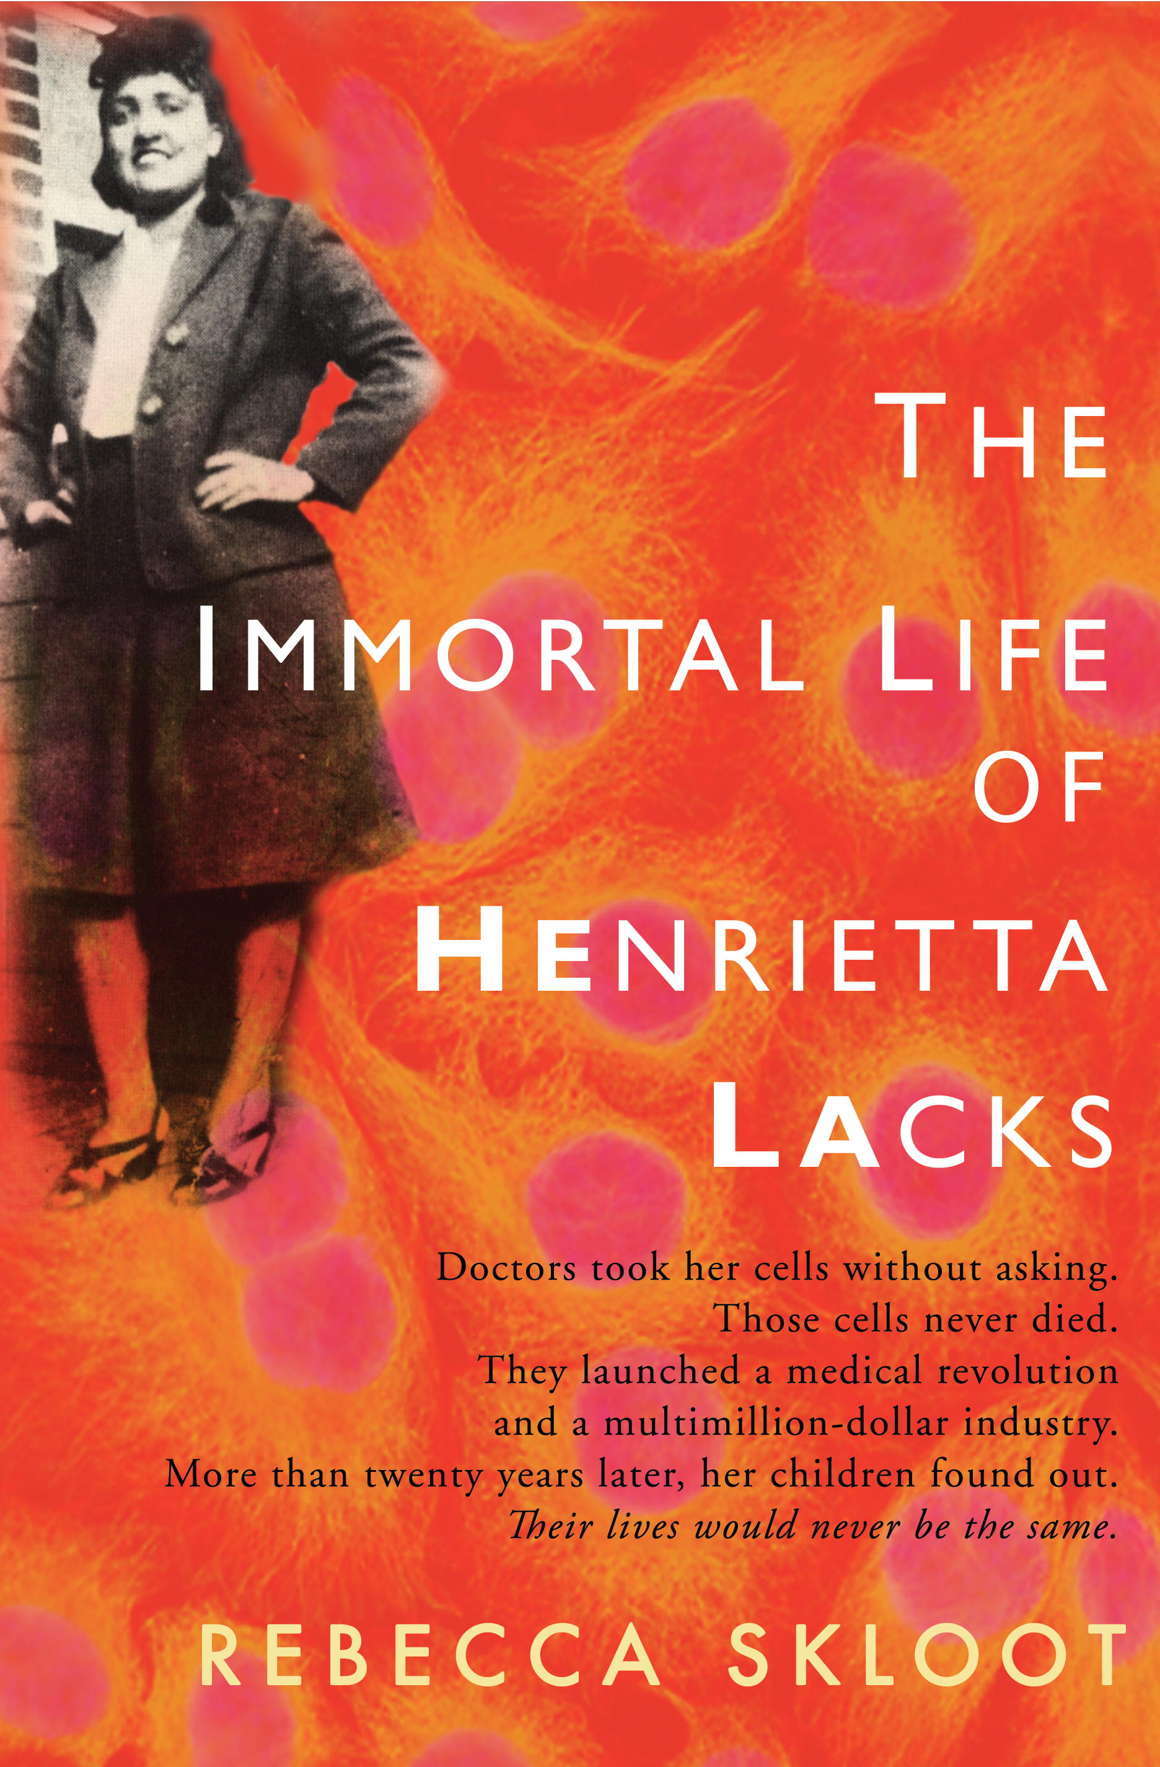
Henrietta Lacks: “HeLa” Cells
Henrietta Lacks was a black tobacco farmer and mother of five, and though she died in 1951, her cells, code-named HeLa, live on. They were used to help develop our most important vaccines and cancer medications, in vitro fertilization, gene mapping, cloning.
The family didn’t learn of the cells until 20 years after Lacks’s death, when scientists began using her children in research without their knowledge. Later their medical records were released to the press and published without consent.

Slide 24
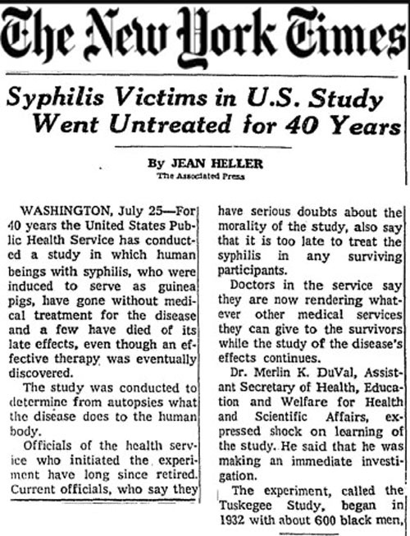
Research Guidelines in GH Ethics
Nuremberg Code, 1948
First U.S. guide for human research
WMA’s Declaration of Helsinki, 1964
Most influential international research ethics guidelines
Key audience is physicians
Belmont Report, 1974
U.S. National Research Act
US Patient’s Bill of Rights, 1996
Not specific to research
Authoritative legal document emphasizing patient autonomy/rights
Notes:
Emerged in response to violations/abuses of vulnerable peoples

Slide 25
Declaration of Helsinki
Read Table 4-2 (Skolnik, p78) and skim the revised Declaration of Helsinki (2013)
Guidelines include:
Duty in Research: to protect life and dignity of participant
Conform to science
Benefits to participant should outweigh risks
Research should stop if risks become > benefits
Participation must be voluntary and with informed consent
Privacy and confidentiality protected
Tests of medicine must be against best available option
Participants should receive access to tools developed
Discussion Question: Are there any elements of the Declaration of Helsinki that surprise you or that you find interesting or extra important?

Slide 26
Case Discussion: Research Studies
In recent history, the ACTG 076 and the Short-Course AZT Trials famously brought global health research ethics to the forefront…
Read the 1994 NEJM “ACTG 076” Study Abstract; then read the 1997 NEJM “Unethical Trials” editorial (p 853ff)
Discussion:
Do you think the Short-course trials alluded to were unethical?
How does the Declaration of Helsinki inform the discussion?
How does the Declaration of Helsinki fail to offer help/guidance?
Notes:
See JAMA “The 50th Anniv of Dec of Helsinki: Progress but many remaining challenges” for Q3

Slide 27
Case Discussion: Resource Investment
In The End of Poverty, Jeffrey Sachs argues that “the Big Five” (interventions of agricultural inputs, preventive and basic health investments, investments in education, infrastructure services, water/sanitation services) would cost approximately $70 per person per year, with “astounding” benefits. (Sachs, End of Poverty, pp232-235)
Bill Gates, founder of PATH and GAVI, meanwhile points out that immunizations are one of the best public health investments of all: Just 23 cents for measles immunity, for example.
Meanwhile, ART in Africa costs approximately $1200+ per person per year.
Discussion:
Do you think the provision of ART in Africa is a wise use of global funds?
Should ART in Africa be considered a “right”?

Slide 28
Case Discussion: Health Workforce
Theresa is a young doctor in Zimbabwe, directing a hospital in Mashingo. She is a gifted, bilingual surgeon and speaker, who has published a few excellent research studies. At a conference in Europe, she receives an invitation to apply full-time as faculty at a prestigious university in the U.S.
Discussion: What ethical concerns does this raise?

Slide 29
Global Health Workforce

Slide 30
Global Health Workforce

Slide 31
Global Health Workforce Ethics
Stemming the Brain Drain — A WHO Global Code of Practice on International Recruitment of Health Personnel
Shortage of 4.3 million health professionals required for delivering essential health care services to populations in need.
International migration and recruitment of health personnel from low- and middle-income countries is an important contributing factor. In Zimbabwe, for example, of 1200 physicians trained between 1990 and 2001, only 360 remained in the country in 2006.
WHO Global Code of Practice on the International Recruitment of Health Personnel, adopted by the 193 member states of the World Health Assembly (WHA) in May 2010, is a critical multilateral framework for tackling the shortage in the global health workforce and the migration of health care workers from low- and middle-income countries.
Includes: 1) transparency; 2) honoring contracts; 3) freedom of choice; 4) data tracking; 5) priority considerations for developing countries
Allyn L. Taylor, J.D., J.S.D., Lenias Hwenda, Ph.D., Bjørn-Inge Larsen, M.D., and Nils Daulaire, M.D.
N Engl J Med 2011; 365:2348-2351December 22, 2011

Slide 32
Additional GH Ethics Issues: International Cooperation
The outbreak of Ebola in 2013-14 in West Africa was devastating to the affected countries. The threat to high-income countries was generally easily minimalized.
Discussion:
What are the ethical arguments to compel high-income countries to help?

Slide 33
Additional GH Ethics Issues: Short Term Trip Ethics
WEIGHT Guidelines
Principles Include:
Preparation
Address local needs
Sustainable change
Respect for host
Fair compensation
Additional Resources: When Helping Hurts (Ficker) and Hoping to Help (Lasker)

Slide 34
Wrap Up
GH Ethics emphasizing social justice/equity/rights
Ethical principles and historical contributions/oaths
Human Rights as important component
Important historical examples/violations: Nazi experiments, Tuskegee, Willowbrook, HeLa Cells
Key guiding documents
UNDHR Article 25 (1948)
Declaration of Helsinki (1964 → 2013)
CIOMS International Ethical Guidelines for Biomedical Research (2002)
WHO Ethical Considerations for HIV Trials (2007)
WEIGHT Guidelines for Short-Term Global Health (2010)

Slide 36
Case Discussion: Jimmy Tripster, MS4
Jimmy’s stoked. He’s a 23 year old 4th yr med student and he’s heading to Cambodia for a month for a medical rotation. He’s excited to use his skills and knowledge to serve the poor. He met a retired nurse, Debbie, last year who had gone on a trip to Cambodia, was disturbed by the suffering she saw, and came home with a commitment to return annually to help. Jimmy will be joining her team in July, along with 2 other nurses, one resident, and one pastor.
They will work with a Cambodian doctor whom Debbie met in Phnom Penh on her first trip. She will take them to her rural home province of Kracheh where they will do 8 days’ worth of village mobile clinics in 8 different villages. They’ll be armed to the hilt with donated meds and even have a sweet procedure station set up. A group of high schoolers will work alongside them as translators. The village mayors welcome the help and have given the team permission.
The team will then debrief in Siem Reap, with a chance to see the famous Angkor Wat.
Have fun, Jimmy! Thanks for serving the poor.
Case Discussion: Jimmy Tripster, MS4

Slide 37
TI’s Corruption Perceptions Index 2010

Slide 38
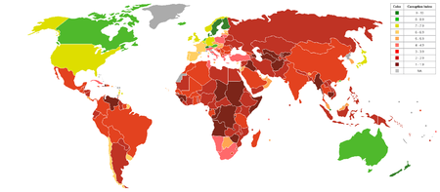
TI Corruption Perceptions Index 2012
Measures corruption in public sector using perceptions
Scores 0-100
2012 CPI:
Denmark #1
US #19
Botswana #30
China #80
Mexico #105
Honduras #133
Haiti #165
Cambodia #157
Somalia, Afghanistan, N Korea #174
Transparency International, 2012 (www.transparency.org)

Slide 40
CPI 2010
2-yr survey-based aggregate indicator based on evals of 13 sources f/ 10 independent institutions
Public and political sectors measured
Country experts and business leaders
10 = very clean / 0 = highly corrupt
3/4ths of world below 5.0

Slide 41
Case Discussion: Corruption
The US Ambassador to Cambodia estimated in 2008 that 500 million USD of foreign aid were lost to corruption.
After over 20 years of relative peace and a 6+% economic growth rate, health care in Cambodia is still 50% dependent on foreign aid.
How should/can approaches to foreign aid be adjusted given the realities of corruption?

Slide 42
Carl Taylor’s “Free Version of the Hippocratic Oath” (1966)
“I will share the science and art by precept, by demonstration, and by every mode of teaching with other physicians regardless of their national origin.
I will try to help secure for the physicians in each country the esteem of their own people, and through collaborative work see that they get full credit.
I will strive to eliminate sources of disease everywhere in the world and not merely set up barriers to the spread of disease to my own people.
I will work for understanding of the diverse causes of diseases, including social, economic, and environmental.
I will promote the well-being of mankind in all its aspects, not merely the bodily, with sympathy and consideration for a people’s culture and beliefs.
I will strive to prevent painful and untimely death, and also help parents to achieve a family size conforming to their desires and to their ability to care for their children.
In my concern with whole communities I will never forget the needs of its individual members.”

Slide 43
Hippocratic Oath
I swear by Apollo Physician and Asclepius and Hygieia and Panaceia and all the gods, and goddesses, making them my witnesses, that I will fulfill according to my ability and judgment this oath and this covenant:
To hold him who has taught me this art as equal to my parents and to live my life in partnership with him…I will apply dietic measures for the benefit of the sick according to my ability and judgment; I will keep them from harm and injustice. I will neither give a deadly drug to anybody if asked for it, nor will I make a suggestion to this effect…What I may see or hear in the course of treatment or even outside of the treatment in regard to the life of men, which on no account one must spread abroad…
If I fulfill this oath and do not violate it, may it be granted to me to enjoy life and art, being honored with fame among all men for all time to come; if I transgress it and swear falsely, may the opposite of all this be my lot.

Slide 44
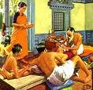
Ayurvedic Code, Susruta (6thC BC)
Students selected based on virtuous character, including compassion, self-control, humble, hard-working)
Consecrated disciples instructed to seek the good of all living creatures, strive to cure all ill, speak honestly, be non-boastful, be self-controlled, not appropriate others’ possessions, enter homes only with permission, not share information about the patient’s home with others, not disclose a poor prognosis if shocking, devote yourself to ongoing learning

Slide 45
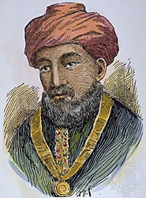
Oath of Maimonides
Commonly attributed to famous Jewish philosopher, Rabbi Moses ben Maimon (AD 12th C), but may have been written later*
Similar principles to Hippocratic Oath and others:
The eternal providence has appointed me to watch over the life and health of Thy creatures. May the love for my art actuate me at all time; may neither avarice nor miserliness, nor thirst for glory or for a great reputation engage my mind; for the enemies of truth and philanthropy could easily deceive me and make me forgetful of my lofty aim of doing good to Thy children.
May I never see in the patient anything but a fellow creature in pain.
Grant me the strength, time and opportunity always to correct what I have acquired, always to extend its domain; for knowledge is immense and the spirit of man can extend indefinitely to enrich itself daily with new requirements.
Today he can discover his errors of yesterday and tomorrow he can obtain a new light on what he thinks himself sure of today. Oh, God, Thou has appointed me to watch over the life and death of Thy creatures; here am I ready for my vocation and now I turn unto my calling.

Slide 46
The Physician’s Oath (Geneva 1948)
I solemnly pledge myself to consecrate my life to the service of humanity;
I will give to my teachers the respect and gratitude which is their due;
I will practice my profession with conscience and dignity; the health of my patient will be my Number One consideration;
I will maintain by all the means in my power, the honour and the noble traditions of the medical profession; my colleagues will be my brothers;
I will not permit considerations of religion, nationality, race, party politics, social standing, or sexual orientation to intervene between my duty and my patient;
I will maintain the utmost respect for human life from the time of conception, even under threat, I will not use my medical knowledge contrary to the laws of humanity;
I make these promises solemnly, freely and upon my honour.^{[3]}

